Slide 1

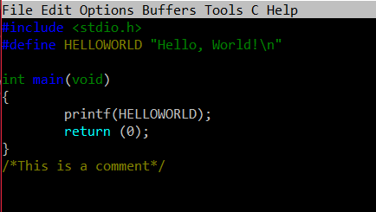
C PROGRAMMING

Slide 2


WHAT IS PROGRAMMING AND CODING?

Slide 3
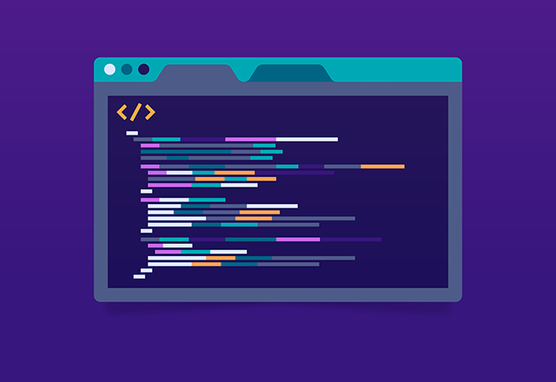
Computer programming is the process that professionals use to write code that instructs how a computer, application or software program performs. At its most basic, computer programming is a set of instructions to facilitate specific actions.
A programming language is a computer language that is used by programmers (developers) to communicate with computers. It is a set of instructions written in any specific language ( C, C++, Java, Python) to perform a specific task.
Coding is a list of step-by-step instructions that get computers to do what you want them to do. Coding makes it possible for us to create computer software, games, apps and websites.

Slide 4
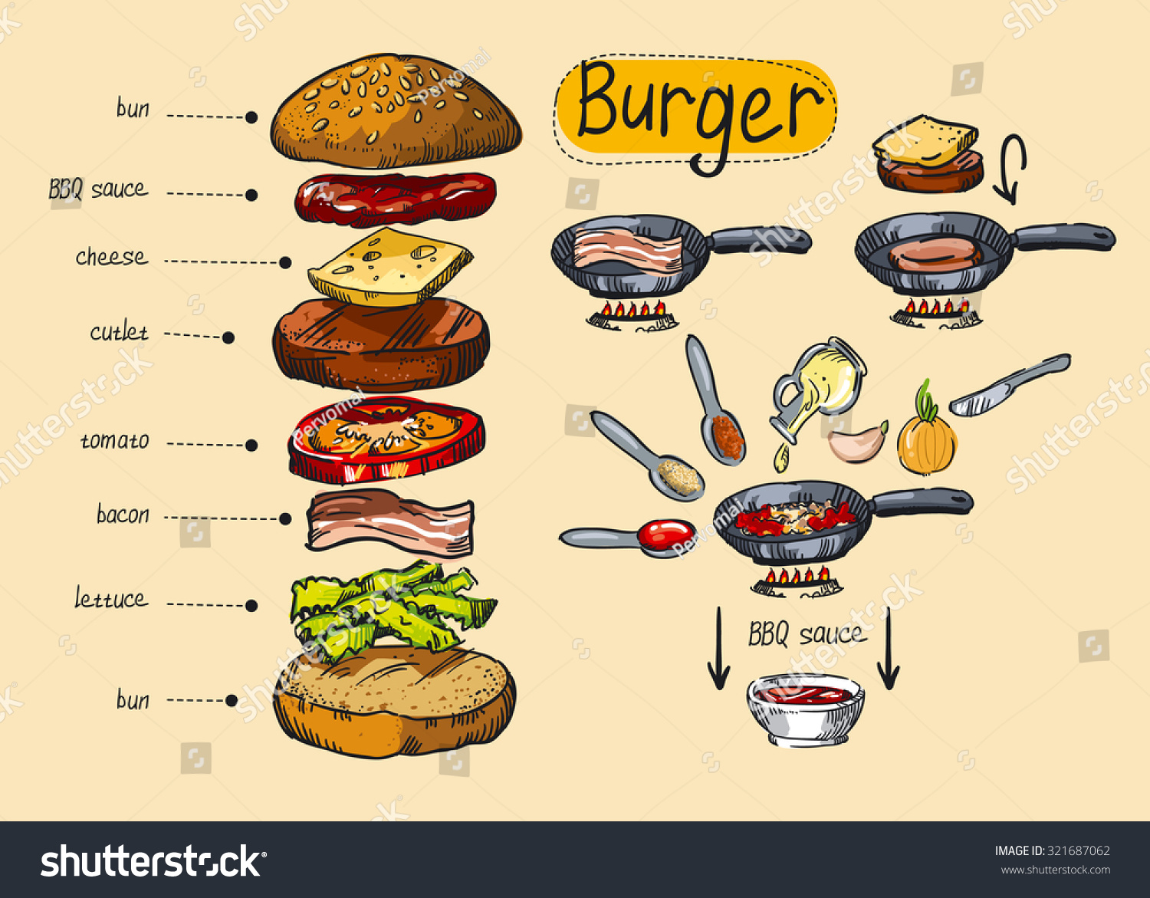

Slide 5
CODING
PROGRAMMING
Coding is just taking part in the process of programming.
A simple text editor is enough for coding and coders do prefer which had good themes in it.
A person should be good at basic knowledge of programming languages and syntax.
Programming is about developing a full-fledged software.
A set of specific tools needed for different tasks such as testing, Debugging, and others.
A person should be expertise in algorithms, problem modeling, and project management

Slide 6
HUMAN LANGUAGE
HIGH – LEVEL LANGUAGES
Low – Level Languages
HARDWARE

Slide 7
HARDWARE
RAM(Random Access Memory) - Random access memory (RAM) is a computer's short-term memory, which it uses to handle all active tasks and apps. None of your programs, files, games, or streams would work without RAM.
ROM(READ ONLY MEMORY) - Read-Only Memory (ROM) is storage technology that permanently stores data in a chip built into computers and other electronic devices.
CPU(Central Processing Unit) - The computer's central processing unit (CPU) is the portion of a computer that retrieves and executes instructions. The CPU is essentially the brain of a CAD system. It consists of an arithmetic and logic unit (ALU), a control unit, and various registers.

Slide 8

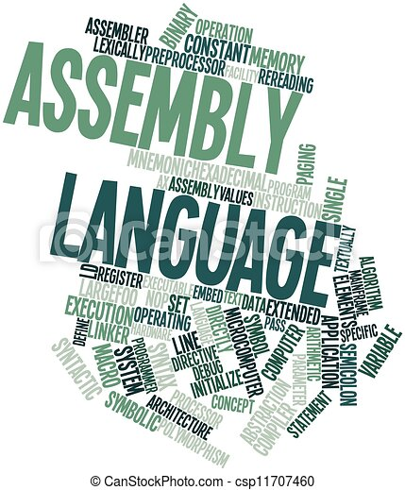

HIGH – LEVEL LANGUAGE
LOW – LEVEL LANGUAGE
High-level programming language (HLL) is designed for developing user-friendly software programs and websites.
The main advantage of a high-level language is that it is easy to read, write, and maintain.
Low-level language is machine-dependent (0s and 1s) programming language.
The processor runs low- level programs directly without the need of a compiler or interpreter, so the programs written in low-level language can be run very fast.
MID – LEVEL LANGUAGE
Middle-level programming language lies between the low-level programming language and high-level programming language. It is also known as the intermediate programming language and pseudo-language.

Slide 9
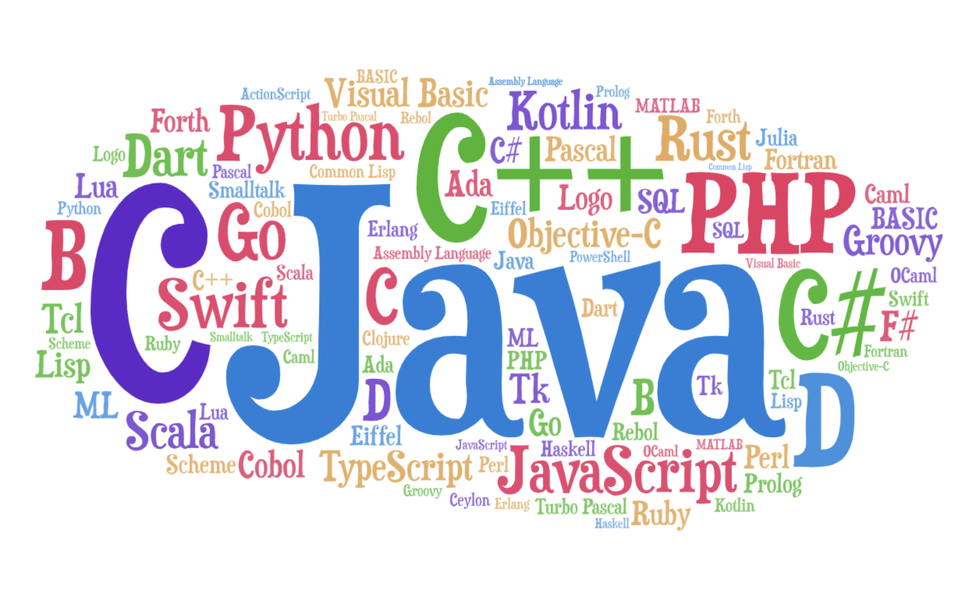
LOW – LEVEL LANGUAGE
Low-level language is further divided into two parts –
Machine Language - Machine language is a type of low-level programming language. It is also called as machine code or object code. Machine language is easier to read because it is normally displayed in binary or hexadecimal form (base 16) form. It does not require a translator to convert the programs because computers directly understand the machine language programs.
Assembly Language - Assembly language (ASM) is also a type of low-level programming language that is designed for specific processors. It represents the set of instructions in a symbolic and human-understandable form. It uses an assembler to convert the assembly language to machine language.

Slide 10
LANGUAGE TRANSLATORS
COMPILER
INTERPRETER
A compiler is a program that converts the entire source code of a programming language into executable machine code for a CPU.
The compiler takes a large amount of time to analyze the entire source code but the overall execution time of the program is comparatively faster.
The compiler requires a lot of memory for generating object codes.
An interpreter takes a source program and runs it line by line, translating each line as it comes to it.
An interpreter takes less amount of time to analyze the source code but the overall execution time of the program is slower.
It requires less memory than a compiler because no object code is generated.

Slide 11
CONVERSION
1 YOTTABYTE – 1000 ZETTABYTE
1 ZETTABYTE – 1000 EXABYTE
1 EXABYTE – 1000 PETABYTE
1 PETABYTE – 1000 TERABYTE
1 TERABYTE – 1000 GIGABYTE
1 GIGABYTE – 1024 MEGABYTE
1 MEGABYTE – 1024 KILOBYTE
1 KILOBYTE – 1024 BYTES
1 BYTES – 8 BITS

